Slide 1
Shaping Health Behaviors

Slide 2
Introductory Terminology
Health behavior – a behavior undertaken by people to enhance/ maintain their health
Health habit – a health behavior that is firmly established and maintained automatically
Health promotion – a process of enabling people to increase their knowledge and control over their health
Primary prevention – taking measures to combat risk factors for an illness before it has a chance to develop
Self-efficacy – the belief that one can control one’s practice of a behavior
Perceived barriers – aspects of one’s life that interfere with practicing good health behaviors (e.g., safety of location, work requirements, insurance access, etc.)

Slide 3
Factors Impacting Health
Demographic factors
Age
Cultural values
Health locus of control
Social influence
Early socialization – The habits introduced during childhood and adolescence have a much stronger impact
Personal goals & values
Symptom awareness
Access to health care
Knowledge & cognition
Emotional factors

Slide 4
What could make health behaviors change (for better or for worse) over time?

Slide 5
Theories of Behavior Change

Slide 6
Health Belief Model
According to this model, whether a person practices a health behavior depends on two factors:
Whether the person perceives a personal health threat
General health values
Specific beliefs about personal vulnerability
Beliefs about consequences of the disorder
Whether the person believes a particular health practice will be effective in reducing that threat
Do they think the health practice will be effective?
Do they think the benefit of the behavior is worth the cost?

Slide 7
Theory of Planned Behavior
According to this theory, a health behavior is the direct result of a behavioral intention
Behavioral intentions are made of three components:
Attitudes toward the specific action
Subjective norms regarding the action
Perceived behavioral control

Slide 8
Self-Determination Theory
Self regulation – the fact that people control their own actions, emotions, and thoughts. Self-regulation can be automatic or intentional.
Centered on the idea that people are actively motivated to pursue their goals
Targets two components:
Autonomous motivation
Perceived competence

Slide 9
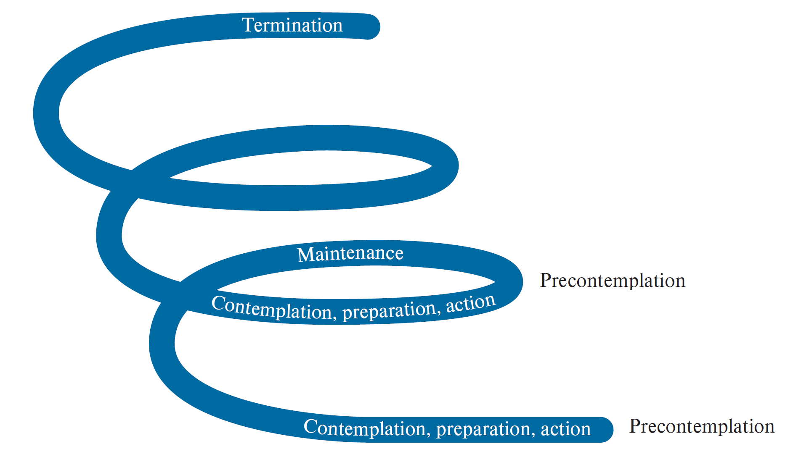
Transtheoretical Model of Behavior Change
Source: Prochaska, James O, Carlo C. DiClemente, and John C. Norcross. “In search of how people change: Applications to addictive behaviors.” American Psychologist 47, no. 9 (September 1992): 1102–1114.

Slide 10
Approaches to Behavior Change

Slide 11
Cognitive Behavior Therapy
A therapy approach that focuses on the target behavior itself, the conditions that elicit and maintain it, and the factors that reinforce it
Can be implemented individually or in groups
First steps often involve self-monitoring and determining any discriminative stimuli
Ex: After monitoring your behavior for a few weeks, you realize the caramel-scented candles make you crave coffee
The second step typically involves removing any discriminative stimuli that you can
Ex: Throwing away wine glasses
The long-term goal of CBT is promoting self-control and cognitive restructuring to change behavior
Ex: shift from “I can’t get through today’s stress without a smoke” to “I can process these feelings on my own without relying on nicotine”

Slide 12
Therapist-Led Interviews and Training
Motivational interviewing
Note: goal is to let the patient discuss their feelings and planned changes
Behavioral assignments
Ex: behavior tracker
Social skills training
Assertiveness training
Relaxation training
Ex: square breathing; grounding

Slide 13
Implementation Intentions
When a person desires to practice a health behavior, it can be achieved by making a simple coherent plan that links critical situations or environmental cues to goal-directed responses
By forming an implementation intention, a person can delegate the control of goal-directed responses to situational cues
Ex: “When I go to the beach, I will put on sunscreen”

Slide 14
Self-Reinforcement
Involves systematically rewarding oneself to increase or decrease the occurrence of a target behavior
Contingency contracting – an individual forms a contract with another person (therapist) as a way to hold them accountable for rewarding/ punishing behavior

Slide 15
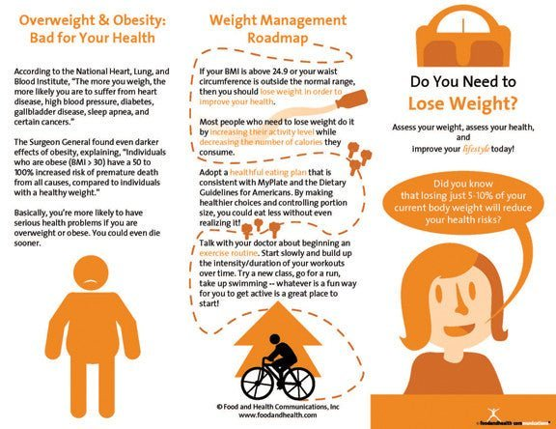
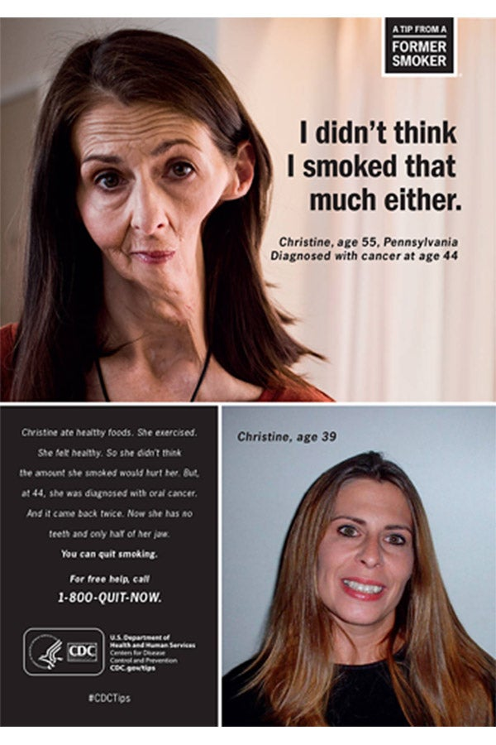
Educational and Emotional Appeals

Slide 16
Social Engineering
An approach where the environment is modified to affect people’s abilities to practice a particular behavior
Often implemented at an over-sight level
Ex: schools requiring a certain amount of exercise; a government requiring a certain series of vaccines; drinking age laws

Slide 17
Relapse

Slide 18
Relapse
What truly constitutes a “relapse?”
Abstinence violation effect – a feeling of loss of control that results when a person has violated self-imposed rules
Relapse prevention – a series of techniques designed to find environments/scenarios that can lead to relapsing, paired with self-talk and other efficacy-promoting techniques to help individuals avoid slipping into previous behavior patterns
Lifestyle rebalancing – adding permanent changes to one’s daily (or weekly) routine to facilitate long-term changes

Slide 19
Venues for Change

Slide 20
Venues for Behavior Change
Practitioner’s office
The family
Self-help groups
Schools
Workplace
Community
Media/ online

